Slide 1

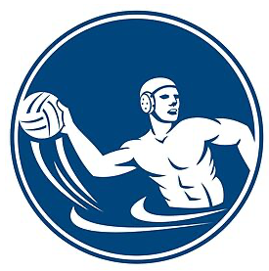
Water Polo

Slide 2
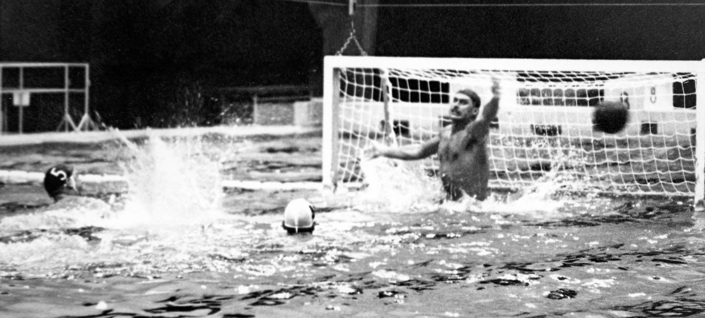
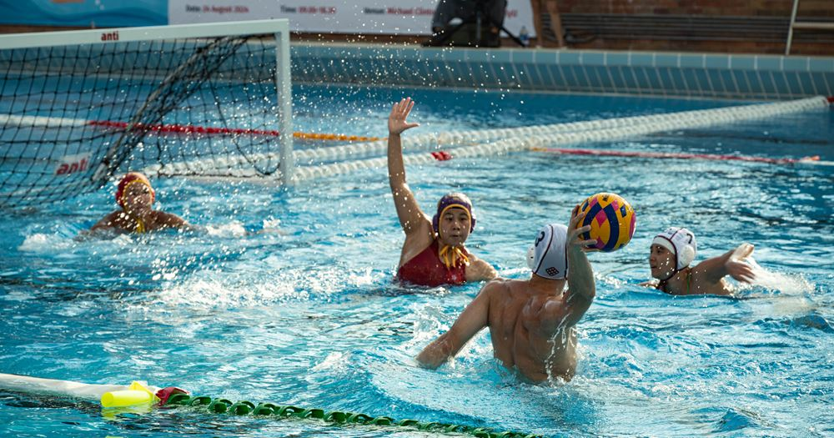
Water Polo
The first attempts of the sport we know today were in English and Scottish lakes and rivers in the mid 19th century. The earliest versions of the aquatic sport have few to none similarities to the water polo we know today. On the island of Great Britain, that sport was a slightly weird, water version of rugby.
Water polo has been part of the Olympic program since the second Olympic Games in 1900. Women’s water polo was introduced at the 2000 Sydney Olympic Games.

Slide 3

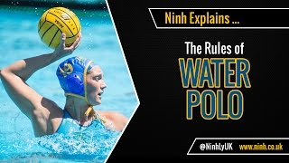
Learn the rules

Slide 4
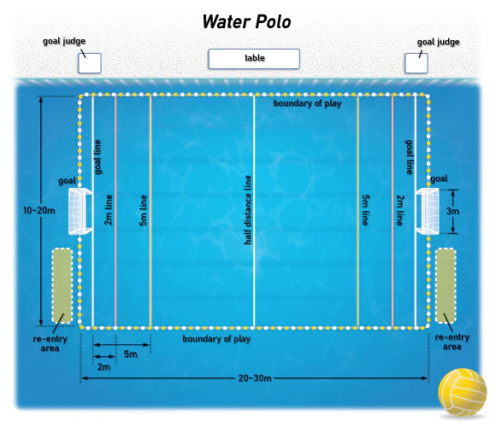
Water Polo Pool

Slide 5
Water polo essential skills:
Swimming Proficiency: Strong swimming skills are crucial for endurance, speed, and maneuverability in the water.
Ball Handling: Players must be adept at passing, catching, and shooting the ball while treading water.
Treading Water: The eggbeater kick is essential for staying afloat and maintaining a stable position while engaging in play.
Defensive Skills: Understanding how to mark opponents, intercept passes, and block shots is vital for effective defense.
Shooting Technique: Developing accurate and powerful shooting skills from various positions enhances scoring opportunities.
Team Communication: Clear communication with teammates is essential for coordinating plays and strategies during the game.
Game Awareness: Understanding the rules, positioning, and dynamics of the game helps players make informed decisions on the field.

Slide 6
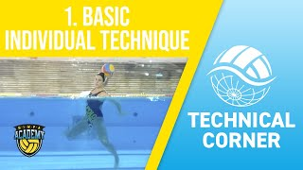
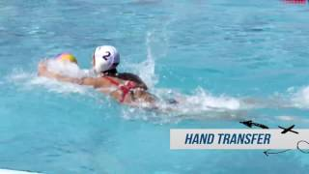
Water polo essential skills:
Ball Handling: Players must be adept at passing, catching, and shooting the ball while treading water. Good ball control is crucial for effective gameplay.

Slide 7
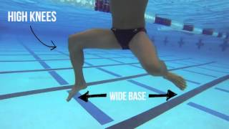
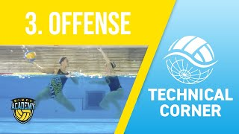
Water polo essential skills:
Treading Water: The eggbeater kick is essential for maintaining a stable position while keeping the head above water. This allows players to be mobile and ready for action.
Offensive techniques includes mastering shots, driving for space, using pick plays, and executing fast breaks for quick scoring opportunities.

Slide 8
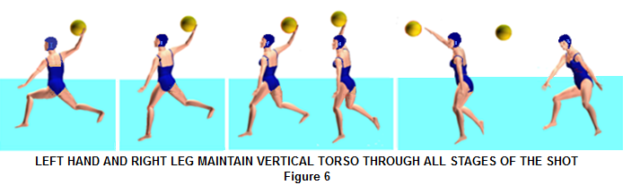
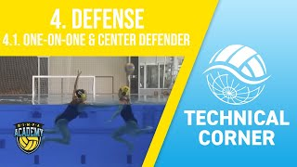
Water polo essential skills:
Shooting Techniques: Players need to master various shooting techniques, such as the outside shot and the backhand shot, to score effectively. Accuracy and power are key components.
Defensive Techniques: Understanding how to mark opponents, intercept passes, and block shots is crucial for defense. Players should also learn how to position themselves effectively in the water.

